Slide 1
VALUE ENGINEERING
Value analysis is one of the major techniques of cost reduction and cost prevention.
It is a disciplined approach that ensures necessary functions for minimum cost without sacrificing quality, reliability, performance, and appearance.
It is an organized approach to identify unnecessary costs associated with any product, material part, component, system or service by analyzing the function and eliminating such costs without impairing the quality, functional reliability, or the capacity of the product to give service

Slide 2
When to Apply Value Analysis
If one or more of the following symptoms are present, starting a VA program will almost certainly produce excellent results:
Company’s products show decline in sales.
Company’s prices are higher than those of its competitors.
Raw materials cost has grown disproportionate to the volume of production.
New designs are being introduced.
The cost of manufacture is rising disproportionate to the volume of production.
Rate of return on investment has a falling trend.
Inability of the firm to meet its delivery commitments.

Slide 3
Aims of Value Engineering
Simplify the product.
Use (new) cheaper and better materials.
Modify and improve product design.
Use efficient processes.
Reduce the product cost.
Increase the utility of the product by economical means.
Save money or increase the profits.

Slide 4
Value Engineering Procedure
The basic steps of value engineering are as follows:
(a) Blast (i) Identify the product.
(ii) Collect relevant information.
(iii) Define different functions.
(b) Create (iv) Different alternatives.
(v) Critically evaluate the alternatives.
(c) Refine (vi) Develop the best alternative.
(vii) Implement the alternative.

Slide 5
MAKE OR BUY DECISIONS
In the process of carrying out business activities of an organization, a component/product can be made within the organization or bought from a subcontractor; each decision involves its own costs.
The Organization should evaluate the costs and benefits of manufacturing a product or product component against purchasing it and then select the alternative which results in the lower cost.

Slide 6
Criteria for Make or Buy
Criteria for make
The finished product can be made cheaper by the firm than by outside suppliers.
The finished product is being manufactured only by a limited number of outside firms which are unable to meet the demand.
The part has an importance for the firm and requires extremely close quality control.
The part can be manufactured with the firm’s existing facilities and similar to other items in which the company has manufacturing experience.

Slide 7
Criteria for buy
Requires high investments on facilities which are already available at suppliers plant.
The company does not have facilities to make it and there are more profitable opportunities for investing company’s capital.
Existing facilities of the company can be used more economically to make other parts.
The skill of personnel employed by the company is not readily adaptable to make the part.
Patent or other legal barriers prevent the company for making the part.
Demand for the part is either temporary or seasonal.

Slide 8
Make or Buy Decision Approaches
Simple Cost Analysis
Example: A company has extra capacity that can be used to produce a sophisticated fixture which it has been buying for N900 each. If the company makes the fixtures, it will incur materials cost of N300 per unit, labour costs of N 250 per unit, and variable overhead costs of N100 per unit. The annual fixed cost associated with the unused capacity is N1,000,000. Demand over the next year is estimated at 5,000 units. Would it be profitable for the company to make the fixtures?

Slide 9
Solution: assume that the unused capacity has alternative use.
Cost to make:
Variable cost = material + labour + overhead
= N(300 + 250 + 100) = N650
Total variable cost = (5,000 units) (N650/unit)
= N3,250,000
Add fixed cost associated with unused capacity
Total cost = N3,250,000 + N1,000,000
= N4,250,000

Slide 10
Cost to buy:
Purchase cost = (5,000 units) (N900/unit)
= N4,500,000
Add fixed cost associated with unused capacity
Total cost = N4,500,000 + N1,000,000
= N5,500,000
Decision: The organization should make the fixtures since the cost of making fixtures is less than the cost of buying fixtures from outside

Slide 11
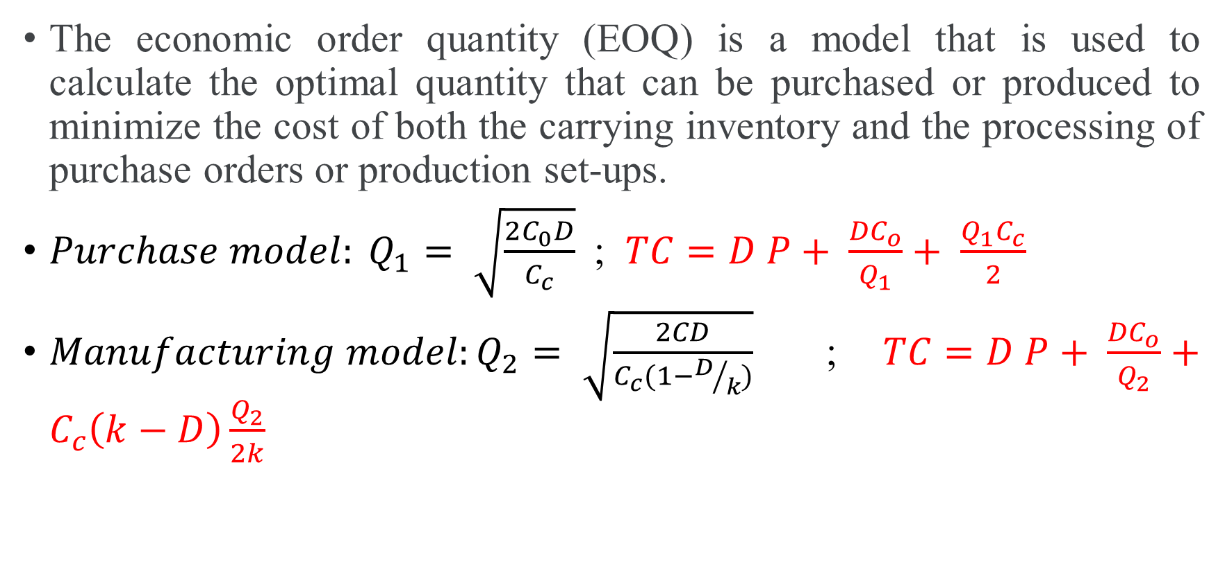
Economic analysis
The economic order quantity (EOQ) is a model that is used to calculate the optimal quantity that can be purchased or produced to minimize the cost of both the carrying inventory and the processing of purchase orders or production set-ups.
$Purchase model: Q_{1}= \sqrt{\frac{2C_{0}D}{C_{c}}}$; $TC=D P+ \frac{{DC}_{o}}{Q_{1}}+ \frac{Q_{1}C_{c}}{2}$
$Manufacturing model:Q_{2}= \sqrt{\frac{2CD}{C_{c}(1−D/k)}}$ ; $TC=D P+ \frac{{DC}_{o}}{Q_{2}}+C_{c}\left(k−D\right)\frac{Q_{2}}{2k}$

Slide 12
Where:
D = demand/year
P = purchase price/unit
C_{c} = carrying cost/unit/year (holding cost)
C_{o} = ordering cost/order or set-up cost/set-up
k = production rate (No. of units/year)
Q₁ = economic order size
Q₂ = economic production size
TC = total cost per year

Slide 13
Example: An item has a yearly demand of 2,000 units. The different costs in respect of make and buy are as follows. Determine the best option.
 | Buy | Make
Item cost/unit | 8 naira | 5 naira
Procurement cost/order | 120 naira
Set-up cost/set-up |  | 60 naira
Annual carrying cost/ item/year | 1.60 naira | 1 naira
Production rate/year |  | 8,000 units

Slide 14
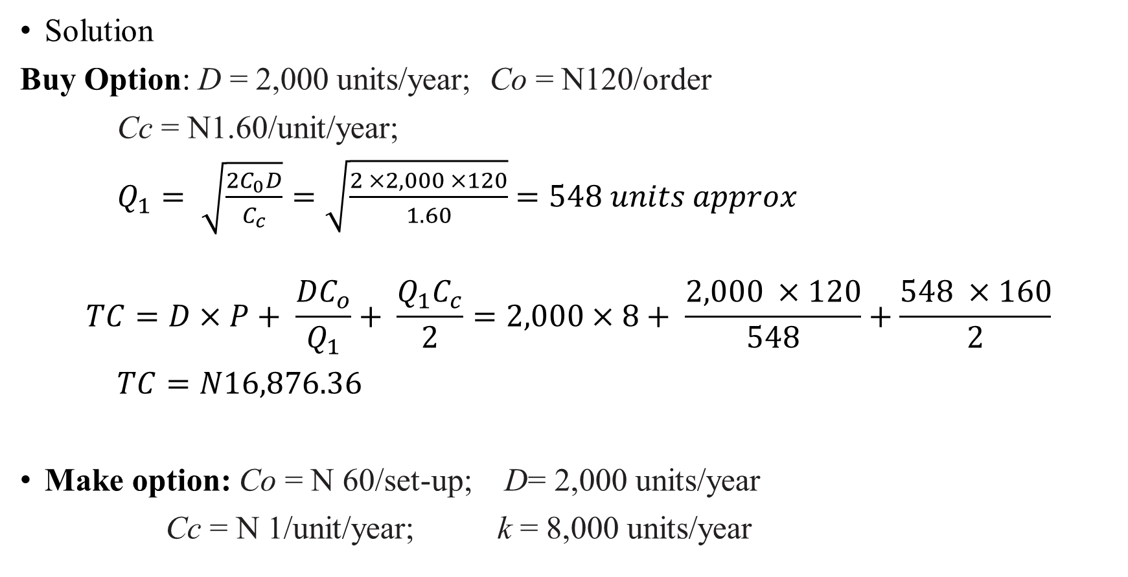
Solution
Buy Option: D = 2,000 units/year; Co = N120/order
Cc = N1.60/unit/year;
$Q_{1}= \sqrt{\frac{2C_{0}D}{C_{c}}}=\sqrt{\frac{2 ×2,000 ×120}{1.60}}$ $=548 units approx$
$$TC=D×P+ \frac{{DC}_{o}}{Q_{1}}+ \frac{Q_{1}C_{c}}{2}=2,000×8+ \frac{2,000 ×120}{548}+\frac{548 ×160}{2}$$
$TC=N16,876.36$
Make option: Co = N 60/set-up; D= 2,000 units/year
Cc = N 1/unit/year; k = 8,000 units/year

Slide 15
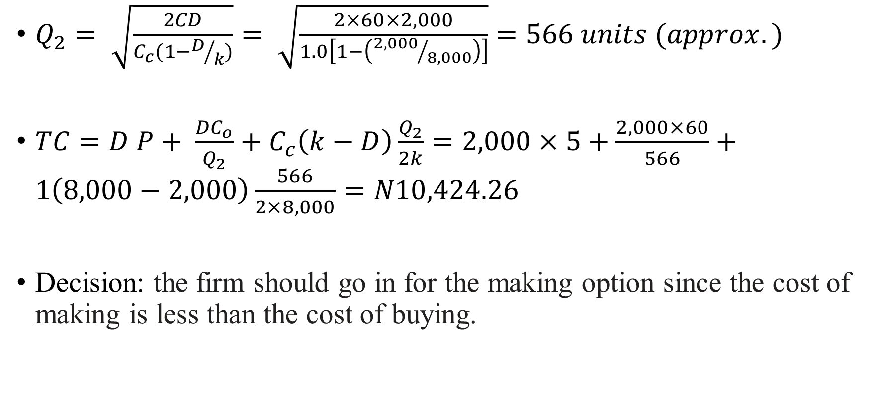
$Q_{2}= \sqrt{\frac{2CD}{C_{c}(1−D/k)}}= \sqrt{\frac{2×60×2,000}{1.0\left[1−\left({2,000}/{8,000}\right)\right]}}$ $=566 units (approx.)$
$TC=D P+ \frac{{DC}_{o}}{Q_{2}}+C_{c}\left(k−D\right)\frac{Q_{2}}{2k}=2,000×5+\frac{2,000×60}{566}+1\left(8,000−2,000\right)\frac{566}{2×8,000}=N10,424.26$
Decision: the firm should go in for the making option since the cost of making is less than the cost of buying.

Slide 16
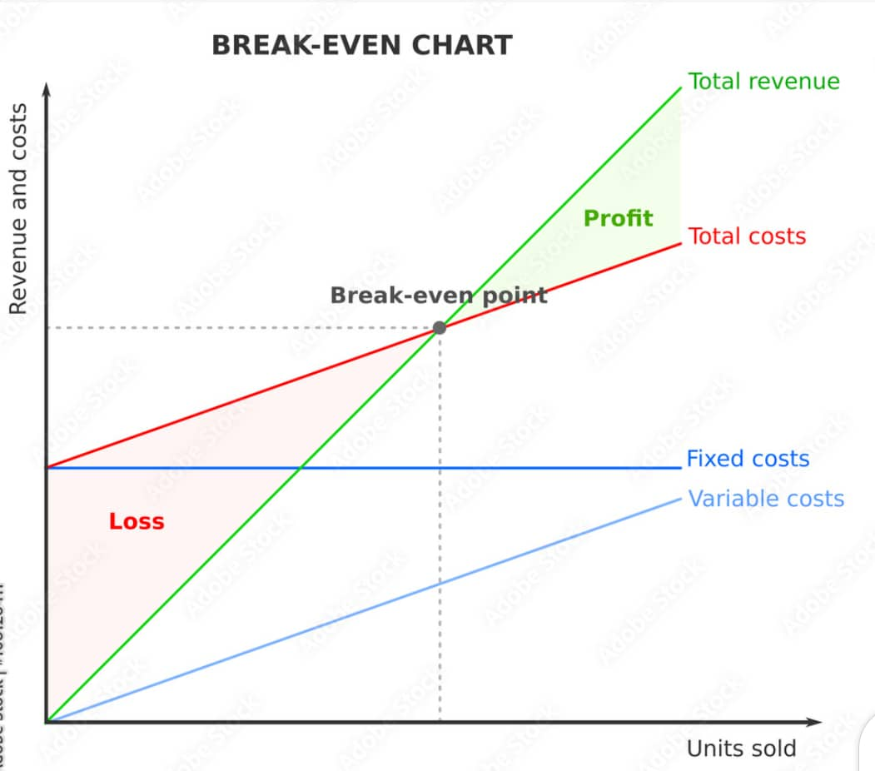
Break-even Analysis
TC = total cost
FC = fixed cost
TC = FC + variable cost
B = the intersection of TC and sales (no loss or no gain situation)
A = break-even sales
C = break-even quantity/break-even point (BEP)
B
A
C

Slide 17
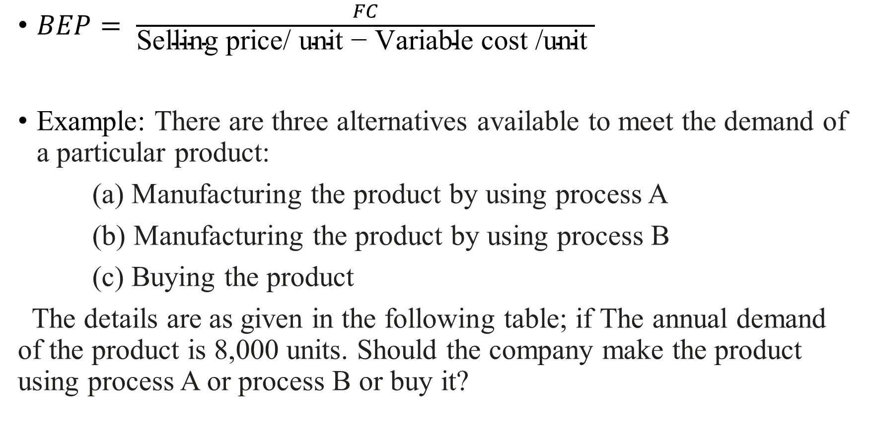
$BEP= \frac{FC}{\text{Selling} \text{price}\text{/ }\text{unit}\text{ − }\text{Variable} \text{cost}\text{ /}\text{unit} }$
Example: There are three alternatives available to meet the demand of a particular product:
(a) Manufacturing the product by using process A
(b) Manufacturing the product by using process B
(c) Buying the product
The details are as given in the following table; if The annual demand of the product is 8,000 units. Should the company make the product using process A or process B or buy it?

Slide 18
Cost elements | Manufacturing the product by process A | Manufacturing the product by process B | Buy
Fixed cost/year (N) | 500,000 | 600,000
Variable/unit (N) | 175 | 150
Purchase price/unit (N) |  |  | 125

Slide 19
Solution
Annual cost of process A = FC + VC = 500,000 + 175*8,000
= N1,900,000
Annual cost of process B = FC + VC = 600,000 + 150*8,000
= N1,800,000
Annual cost of buy = Purchase price/unit Volume
= 125*8,000 = N1,000,000
Decision: since the annual cost of buy option is the minimum among all the alternatives, the company should buy the product

